Slide 1
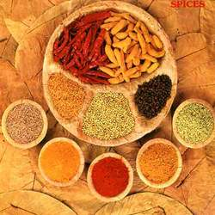
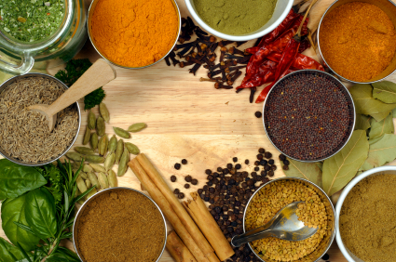
O S Food Pvt Ltd.

Slide 2
About Us
We have traditional business of wholesale spices since the past 50 years & now manufacturing of spices in India, operating successfully since the last 10 years.
We are channel partners with some of the largest wholesale and retail chains of the country like Bharti-Walmart, Metro, Sahara Q-shop, Reliance Fresh, V-Mart, Save Max and Big Bazaar.
Our company is supplying its products in modern trade organizations, in more than 9 states. We have received pleasing responses from all across.
Our company assures you the best customer satisfaction experience.

Slide 3
My Experience with (P) Label
Did the Pvt. Label of Vishal Retail Ltd. (Powdered spices and whole spices)
Doing the pvt.label of Sahara Q Shop.(Powdered spices as well as whole spices)
Did the Pvt. Label for Subhiksha Retail ltd.

Slide 4
Tie-ups
1.Tie-up With Panataloon Retail India LTD. (All Over India)
2.Tie-up With Vishal Retail Ltd.(All Over India)
3.Tie-up With Bharti Wall Mart Cash & Carry
4.Tie-up With Metro Cash & Carry
5.Tie-up With Hariyali Kissan Bazar
6.Tie-up With Big Apple
7.Tie-up with Relaince Cash & Carry.
8.Tie-up with save max
9. Tie-up with V-Mart

Slide 5
My Network
1. Kolkatta
2. Assam
3. Bihar
4. Ranchi
5. Orissa
6. Jammu
7. Delhi
8. Haryana
9. Punjab

Slide 6
NON FORMULATED SPICES
HALDI POWDER
DHANIA POWDER
LAL MIRCH POWDER
AMCHOOR POWDER
RANGEELI MIRCH
MIRCH KUTTI

Slide 7
FORMULATED SPICES
CHAT MASALA
CHANNA MASALA
GARAM MASALA
MEAT MASALA
BIRYANI MASALA
CHICKEN MASALA
PAO BHAJI MASALA
PODINA CHATNI MASALA
SAMBHAR MASALA
RAITA MASALA

Slide 8
FORMULATED SPICES (Cont.)
JAL JEERA POWDER
ACHAAR MASALA
THANDAI POWDER
SUBZI MASALA
SPECIAL KITCHEN KING
SAUNTH POWDER
SAUNF POWDER
JEERA POWDER
KALI MIRCH POWDER
KASOORI METHI
RAJMA MASALA

Slide 9
WHOLE SPICES
SHAH JEERA
KALONJI
TILL WHITE
CHILLI of all varieties
BYADGI CHILLY
POHA
PEANUT
SABOODANA
WATER MELON MAGHAJ
DRY GINGER
FENNEL
CLOVES
CASSIA
BAY LEAF

Slide 10
WHOLE SPICES (Cont.)
JEERA
KALI MIRCH
AJWAIN
DHANIA
METHI
PHOOL MAKHANA
RAI
BLACK MUSTARD
YELLOW MUSTARD
SMALL CARDAMOM
BIG CARDAMOM
MAICE
NUTMEG
METHI DANA

Slide 11
MACHINERY
1. Turmeric Impact Grinder
2. Whole Items Seed Grader (2)
4. Coriander & Other Blend Item Grinder
3. Chilly Impact Grinder

Slide 12
PACKING MACHINES
1. Packing Machine of 50&100gm Pouch(5)
2. Packing Machine of 200gm(2)
3. Packing Machine of 500gm(2)
4. Specialization in Machinery Equipped of 50&100gm Blend items (Liner Cartoon Machine)
5. Packing Machine of 8gm pouch(3)

